Slide 1
STUDY ON DYNAMIC PATH PLANNING
Mid Semester Presentation for Study Project
EEE F266
Under the Guidance of: Dr. Surekha Bhanot
Presented By: Arjun Gupta (2014B4A30754P) and Rasal Kumar (2014B4A80801P)

Slide 2
Introduction
Collision free navigation
Finding shortest routine
Various path planning algorithms using Artificial Neural Networks, genetic algorithms and ant colony optimization (ACO).
ACO has prominent advantages
We propose a model

Slide 3
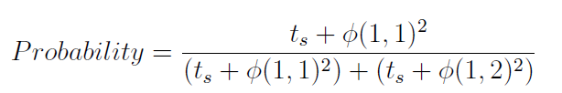
Ant Colony Optimization
Probabilistic technique
Inspired from foraging behaviour of ant species
Ants deposit pheromones
Such behavioural characteristics are used in ACO
Global optimum path
Probability of decision taken by the ant is given by:

Slide 4
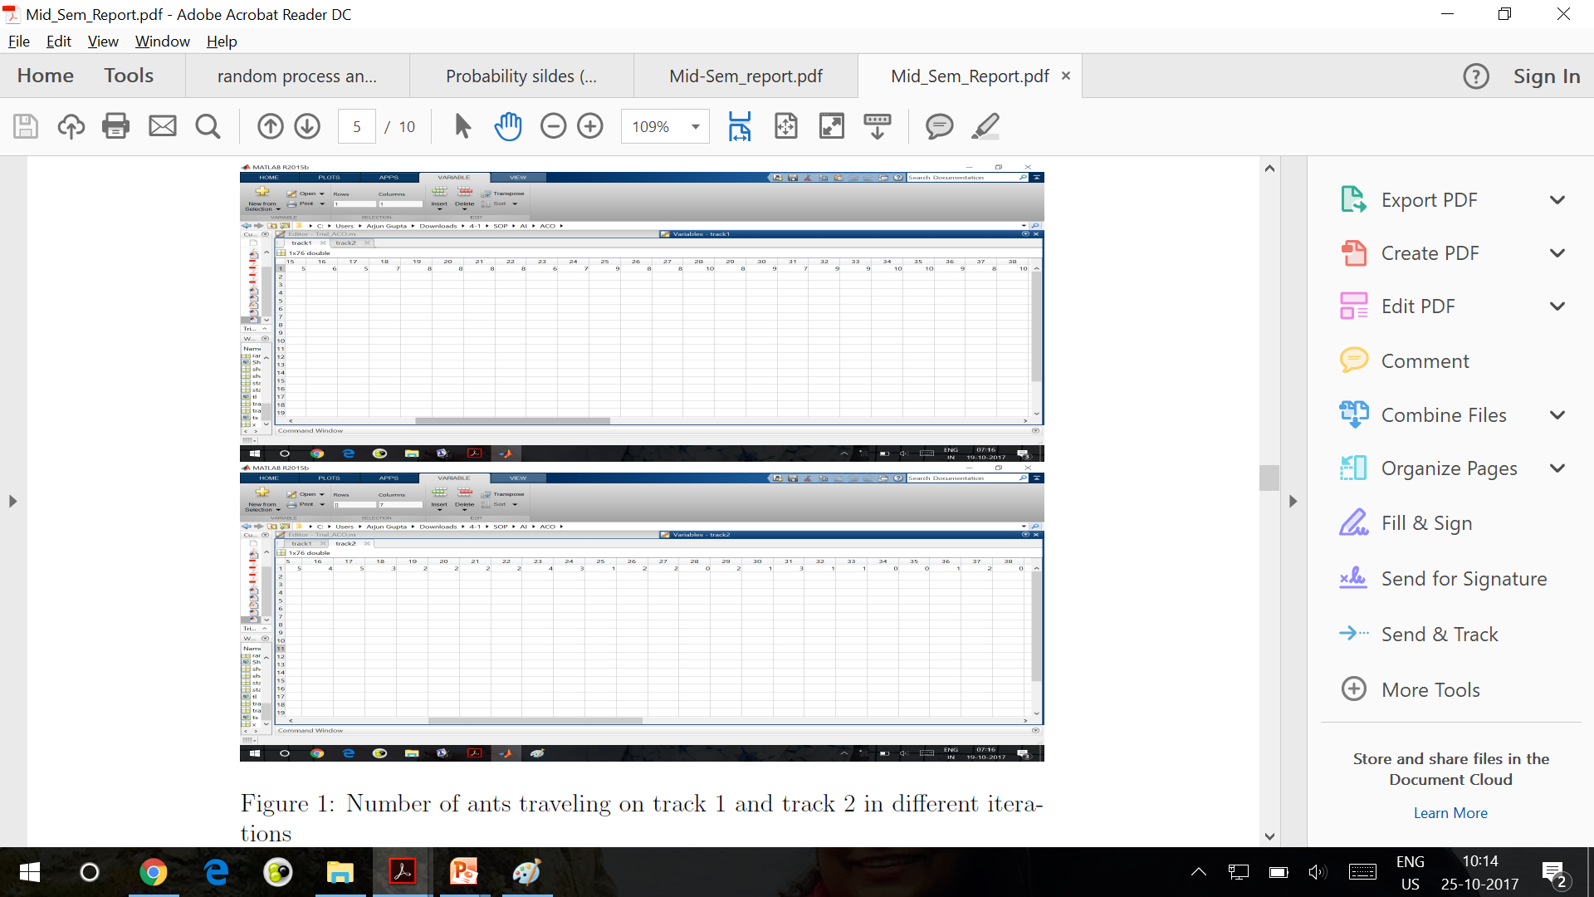
Results obtained in MATLAB are:

Slide 5
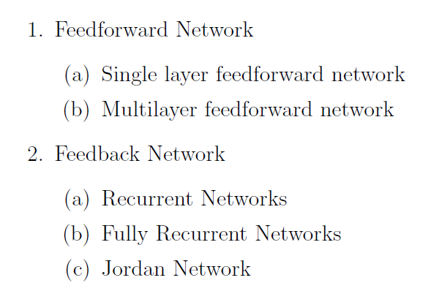
Artificial Neural Network
Efficient computing system
Analogy from biological neural networks
Large collection of units, called neurons
Connection link
Activation signal
As per network topology the ANN can be classified as:

Slide 6
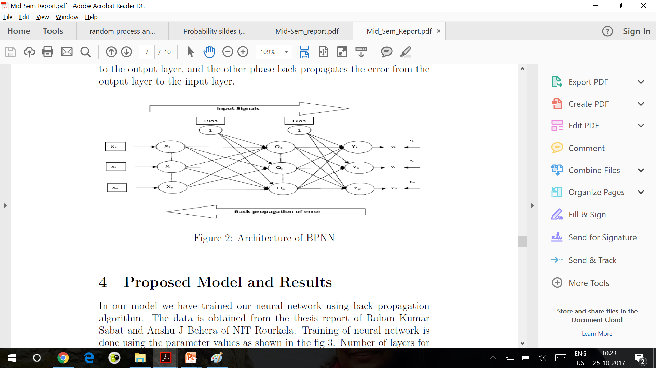
Back Propagation NN
Multi layer NN
Back Propagation takes place
Calculated output is compared with target output
Bias can be given to the layers
Architecture:

Slide 7
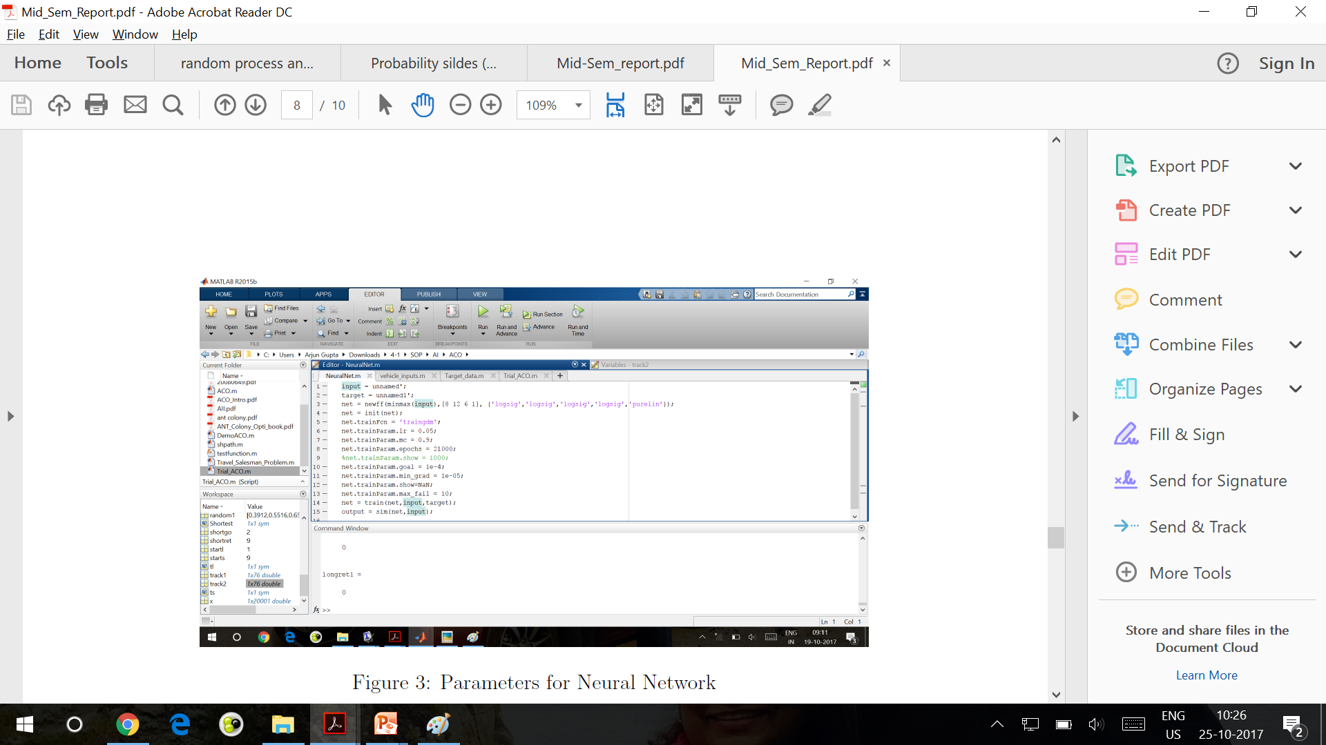
Proposed Model
Heading angle is obtained from NN
NN is trained using Back Propagation Algorithm
Training Parameters:

Slide 8
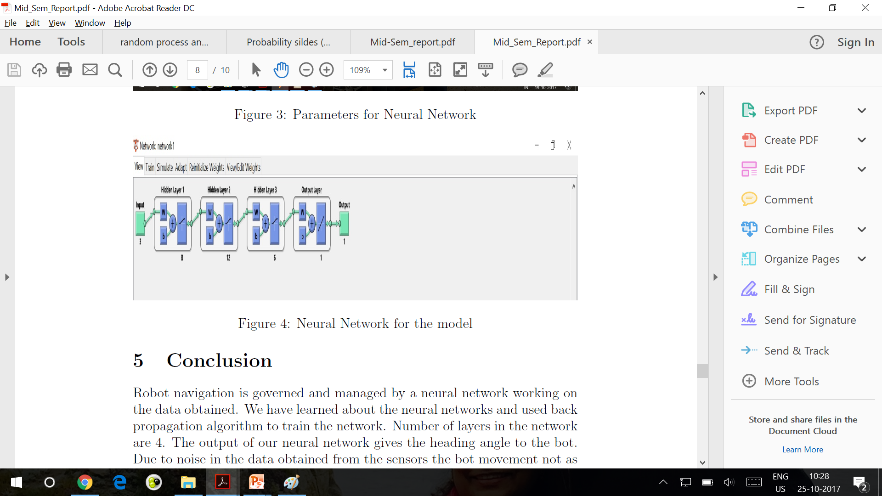
Structure of Neural Network:
Number of layers are determined by choosing optimal simulation results
The data contains 4 columns.

Slide 9
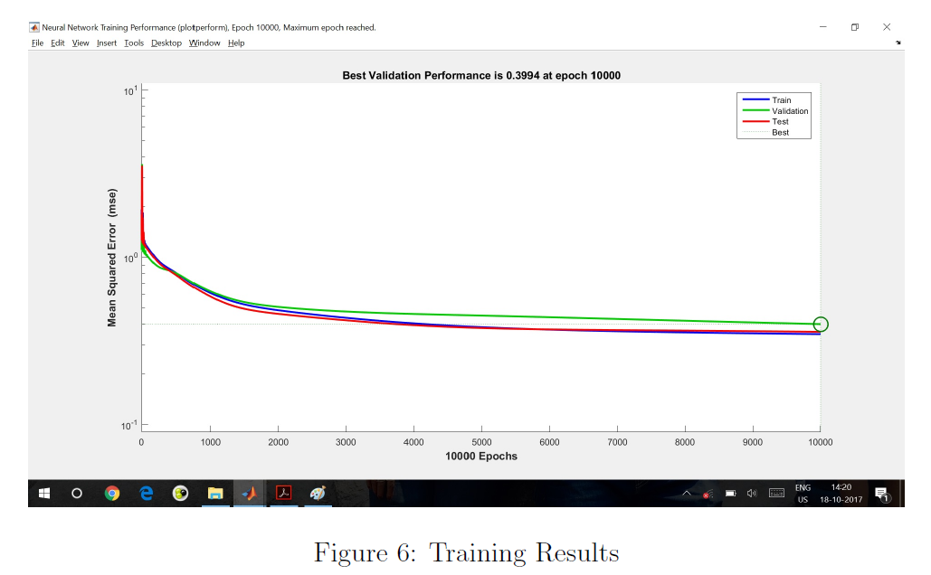
Result from training of Neural Network:

Slide 10
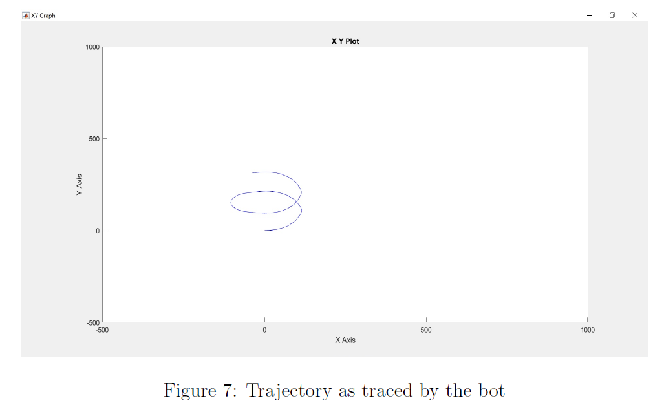
Trajectory of the bot:

Slide 11
Future Expectations
Obtain data by ourselves for future analysis
Implement dynamic path planning algorithm
Model our controller to move along the obtained shortest path

Slide 12
Thank You

